Slide 1
Intermediate Presentation
- Interactive Score Annotation for MIR -
Fernando Perry de Azeredo
up202308655@up.pt
FEUP 2026

Slide 2

Datas de entregas
8 Junho - Validação de dados da tese
  Preencher no Sigarra
  (Link instruções)
15 de Junho – Submissão da tese para defesa (instruções)
30 de Junho – Validação do supervisor
13-24 de Julho – Defesa
30 de Julho – Entrega Final

Slide 4
BeatMapJS (09/2025 - 02/2026 )
Goal: Make a basic beat annotation GUI tool
Tools used: JS/HTML based, BeatThis!, Wavesurfer.JS,
Developed Features:
  Interactive Spectogram
  Web-based interface in JS/HTML
  Beat This! Integration
  Beat Annotation basic tools
  Region Annotation
  Table for editing tempo annotations and descriptions
  Ability to import/export beat annotations to .txt.
Conclusion: No significant contribution for MIR.

Slide 5
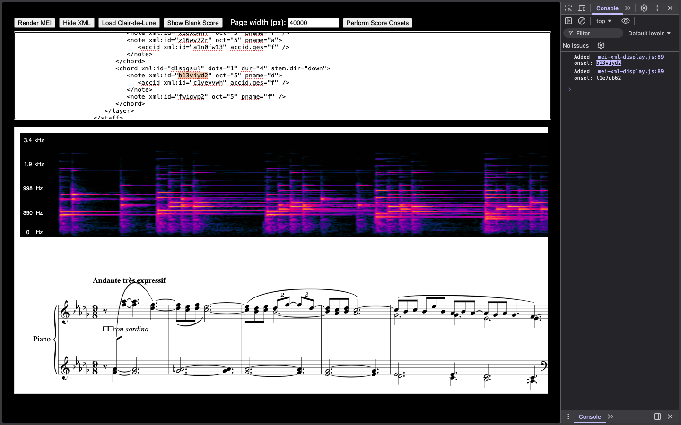
MEI-Basic-Edit (02/2025 - 03/2026 )
Goal: Understand how MEI scores can be manipulated.
Tools Used: JS/HTML, Verovio, SVG, MEI format.
Developed Features:
  MEI Score display.
  XML text editor.
Conclusion: Failed project, however gave me insight on MEI format and Verovio.

Slide 6
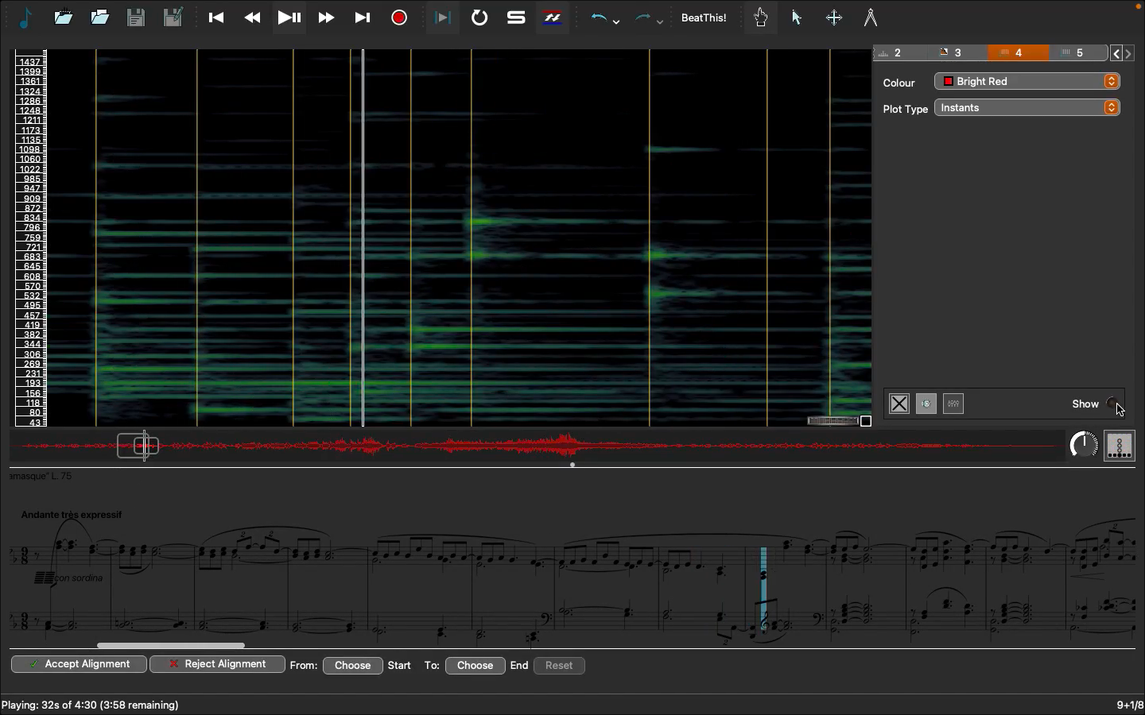
Piano-Precision Fork (03/2025 - 03/2026 )
Goal: To make a Beat Annotation fork of Sonic Visualizer
Developed Features: Beat This! Integration, Automatic Score follow along.
Conclusion: No significant academic contribution.

Slide 7
Score-Allignment.py (03/2025 - 03/2026 )
Goal: Spectogram and Score Visualizer in python
Tools used: Modusa (matplot lib)
Developed Features:
Navigational Spectrogram
Conclusion: Spent way to much time trying to make the spectogram better.

Slide 8
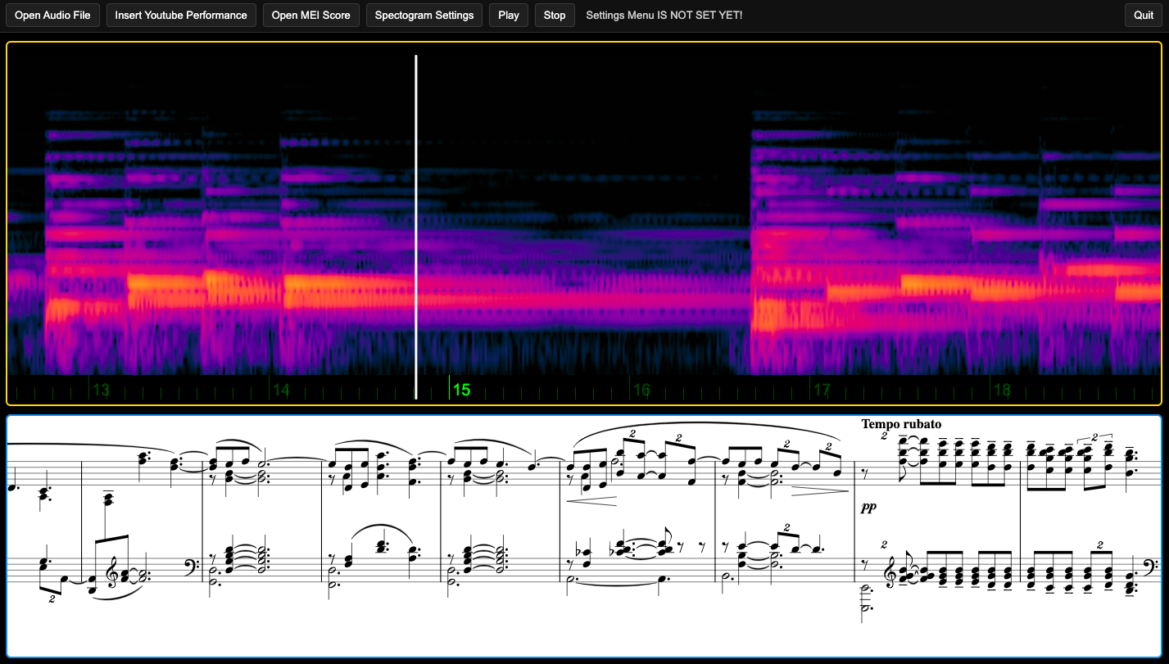
Score-Allignment.js (03/2025 - 03/2026 )
Goal: Redo in JS
Tools used: Wavesuurfer.js and Verovio.
Developed Features:
MEI visualizer
Ability to make time markers within .mei score.
Conclusion: No significant academic addition.

Slide 9
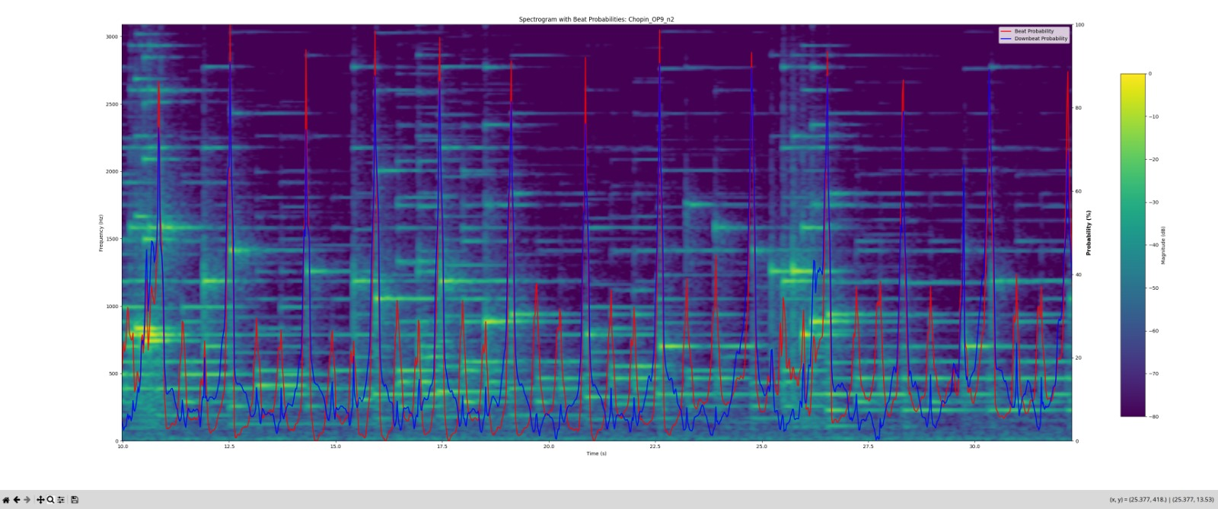
Score-Allignment.js (03/2025 - 03/2026 )
Goal: Make spectogram and score alignment
Goal: Make spectogram and score alignment
Goal: Make spectogram and score alignment
Goal: Make spectogram and score alignment

Slide 10
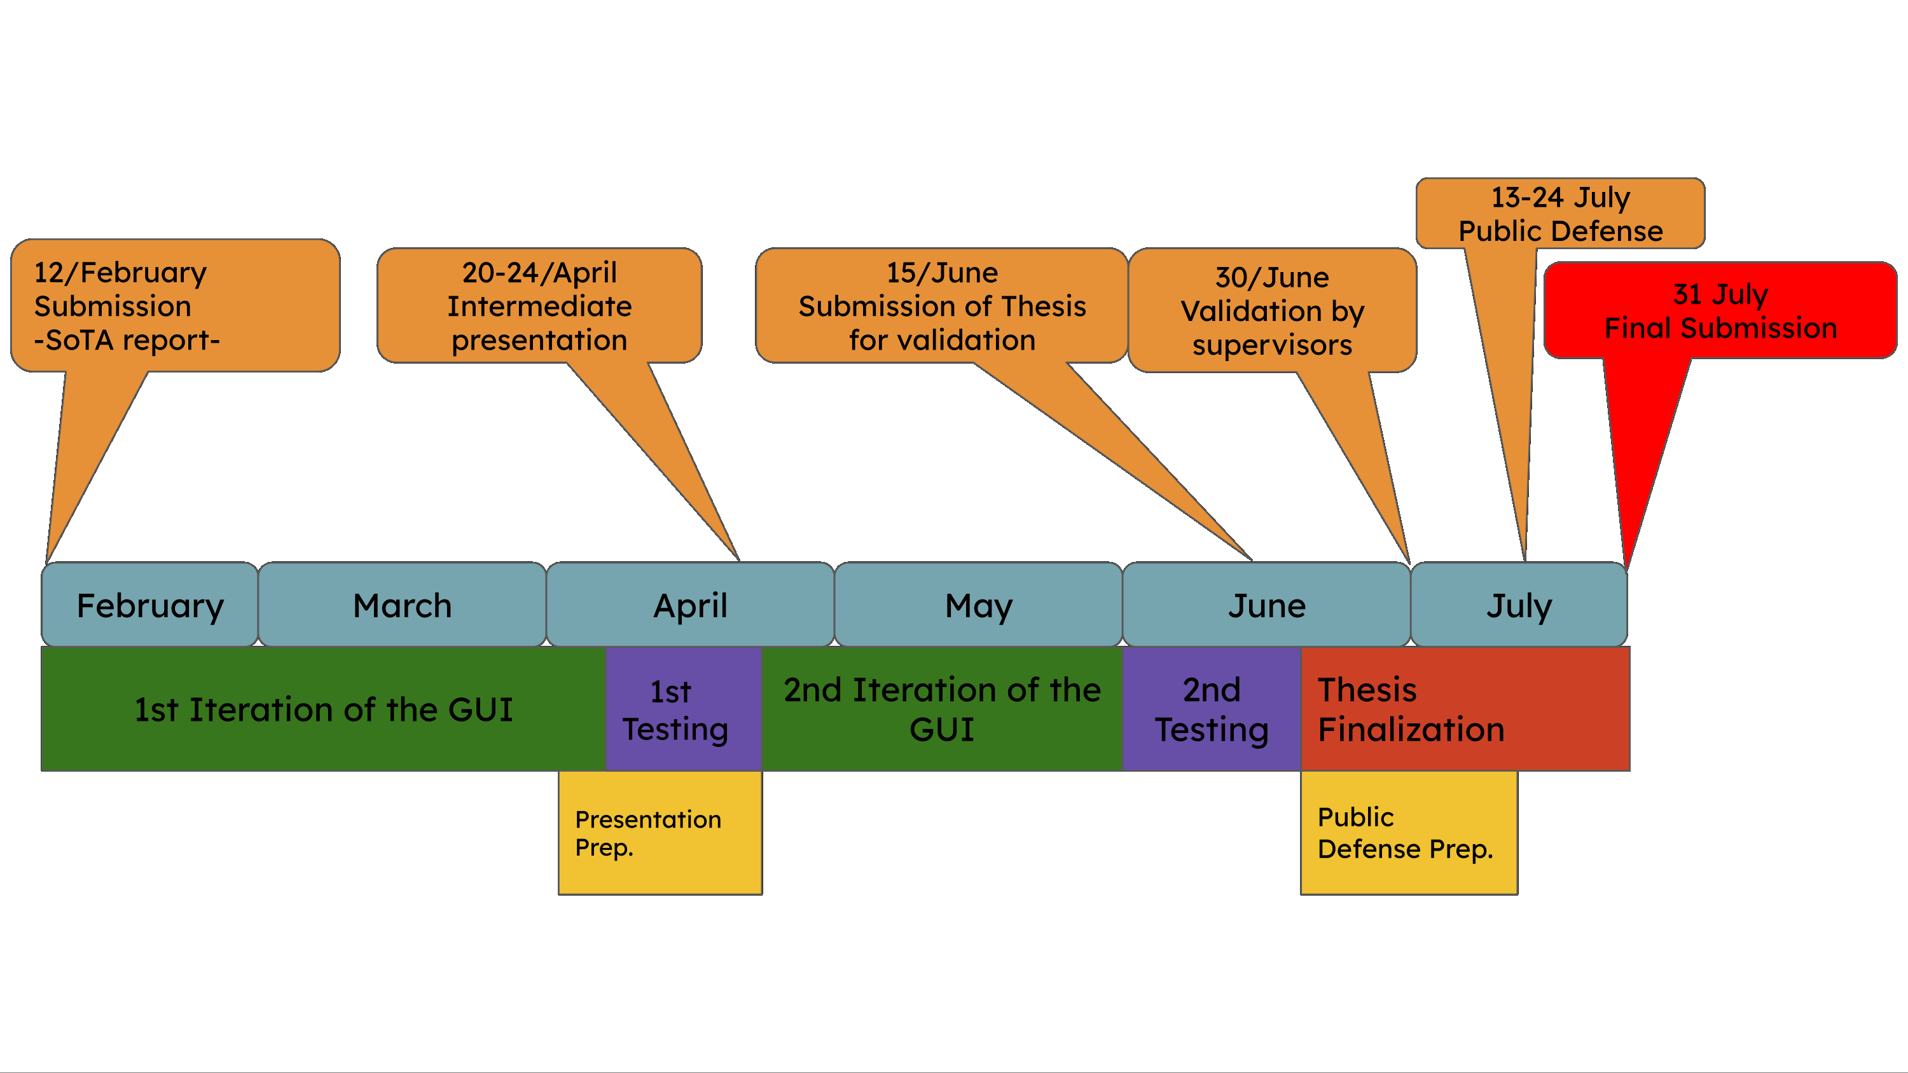
Sota Timeline and Goals

Slide 11
What is going good

